Slide 1
POPULATION GROWTH IN
INDIA
PRESENTED BY
DIPESH PAUDEL (25BCA10060)
SHATAKSHI KHEMANI (25BCA10057)
ISHANT
(25BCA10038

Slide 2
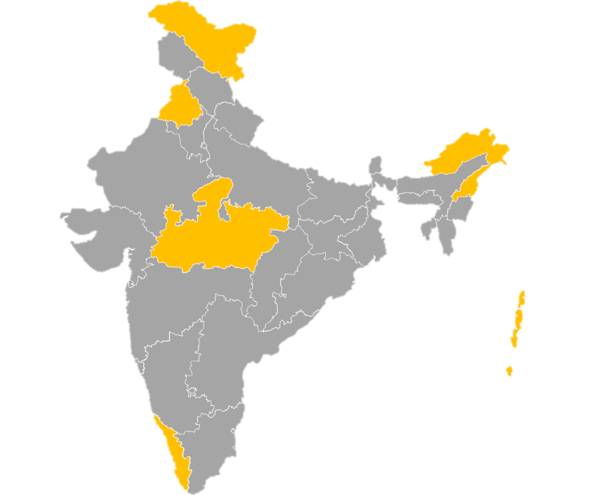


India's Population Dynamics
Challenges and Opportunities of Growth
Defining Population Growth
Population growth refers to the increase in the number of people living in a country or region over a specified period.
A Global Perspective
India is the world's second-most populated country, holding significant weight in global demographics and resource consumption.
Understanding India's population dynamics is crucial, as this growth impacts every aspect of socio-economic and environmental stability, including resource allocation, education, and employment.

Slide 3
Historical Trajectory: India's Population Statistics (1951–2023)
Key Takeaways from Growth Patterns
India's population has increased nearly fourfold since 1951, crossing the 1.4 billion mark.
The most explosive growth rate was observed between 1951 and 1981, marked by high birth rates and decreasing mortality.
Even with a slowing percentage growth rate, India adds approximately 12 million people annually (1.2 crore).
The sheer scale of the population means that absolute growth remains substantial, requiring continuous resource planning.

Slide 4






Core Drivers of India's Population Increase
India's sustained population growth is a complex result of socio-economic, cultural, and medical factors working in tandem.
High Birth Rate
Traditional family structures and the desire for multiple children contribute to higher fertility rates across many regions.
Lower Death Rate
Significant improvements in public health, nutrition, and modern medicine have drastically increased life expectancy and reduced infant mortality.
Early Marriages
Marrying at a young age, particularly in rural areas, extends the reproductive period, leading to larger family sizes.
Illiteracy & Awareness Gaps
Limited education, especially for women, often means a lack of awareness regarding family planning methods and reproductive health.
Socio-Economic Factors
Poverty and a reliance on agriculture lead poor families to view children as necessary financial assets and labor for the future.
Cultural Preference
A strong cultural preference for a male child often leads couples to continue having children until a son is born, enlarging the family unit.

Slide 5
Demographic Dividend: India's Young Population
India possesses a unique demographic structure that positions it as one of the youngest nations globally—a potential source of massive productivity.
Over 39% of India's total population is currently below the age of 25.
This "demographic dividend" represents an opportunity for accelerated economic growth, provided the young workforce is adequately educated, skilled, and employed.

Slide 6
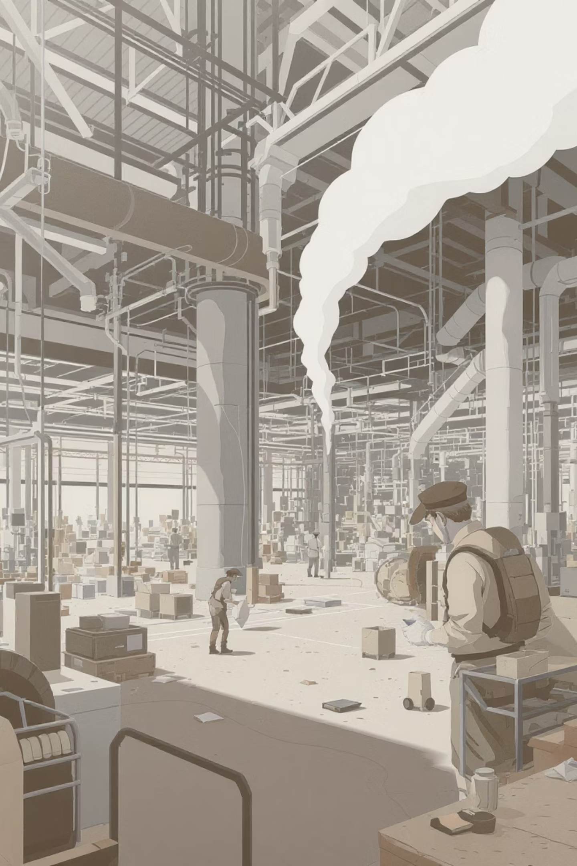
Economic Impacts of High Population
Population growth presents both strengths—the "demographic dividend"—and significant obstacles to economic development.
Positive Economic Impacts (Opportunities)
Massive Workforce: The large young population gives the country a big pool of workers, capable of boosting production and supporting industries..
Expanding Markets: A huge number of consumers attract more global companies and create strong demand for products and services within the country.
Negative Economic Impacts (Challenges)
Rising Unemployment: The number of job seekers grows faster than job openings, leading to more unemployment and underemployment.
Strain on Infrastructure: Overcrowding causes shortages in housing, schools, and hospitals, putting pressure on public facilities and services.
Resource Scarcity: Growing population increases pressure on basic resources like food, clean water, and energy, leading to scarcity and higher costs.

Slide 7




Environmental Consequences of Population Density
Uncontrolled population expansion exacts a heavy toll on India’s natural environment, leading to degradation of vital ecosystems.
Air Quality Decline
Waste & Water Stress
Rapid urbanization and a surge in vehicle ownership contribute directly to severe air pollution and increased greenhouse gas emissions.
More people generate exponentially more waste, overwhelming disposal systems and contaminating limited fresh water sources.
Habitat Loss
Urban Congestion
Expansion of agricultural land and housing necessitates widespread deforestation, disturbing the natural environmental balance and biodiversity.
Overcrowding leads to the formation of informal settlements and slums, severely straining city infrastructure and public services.

Slide 8
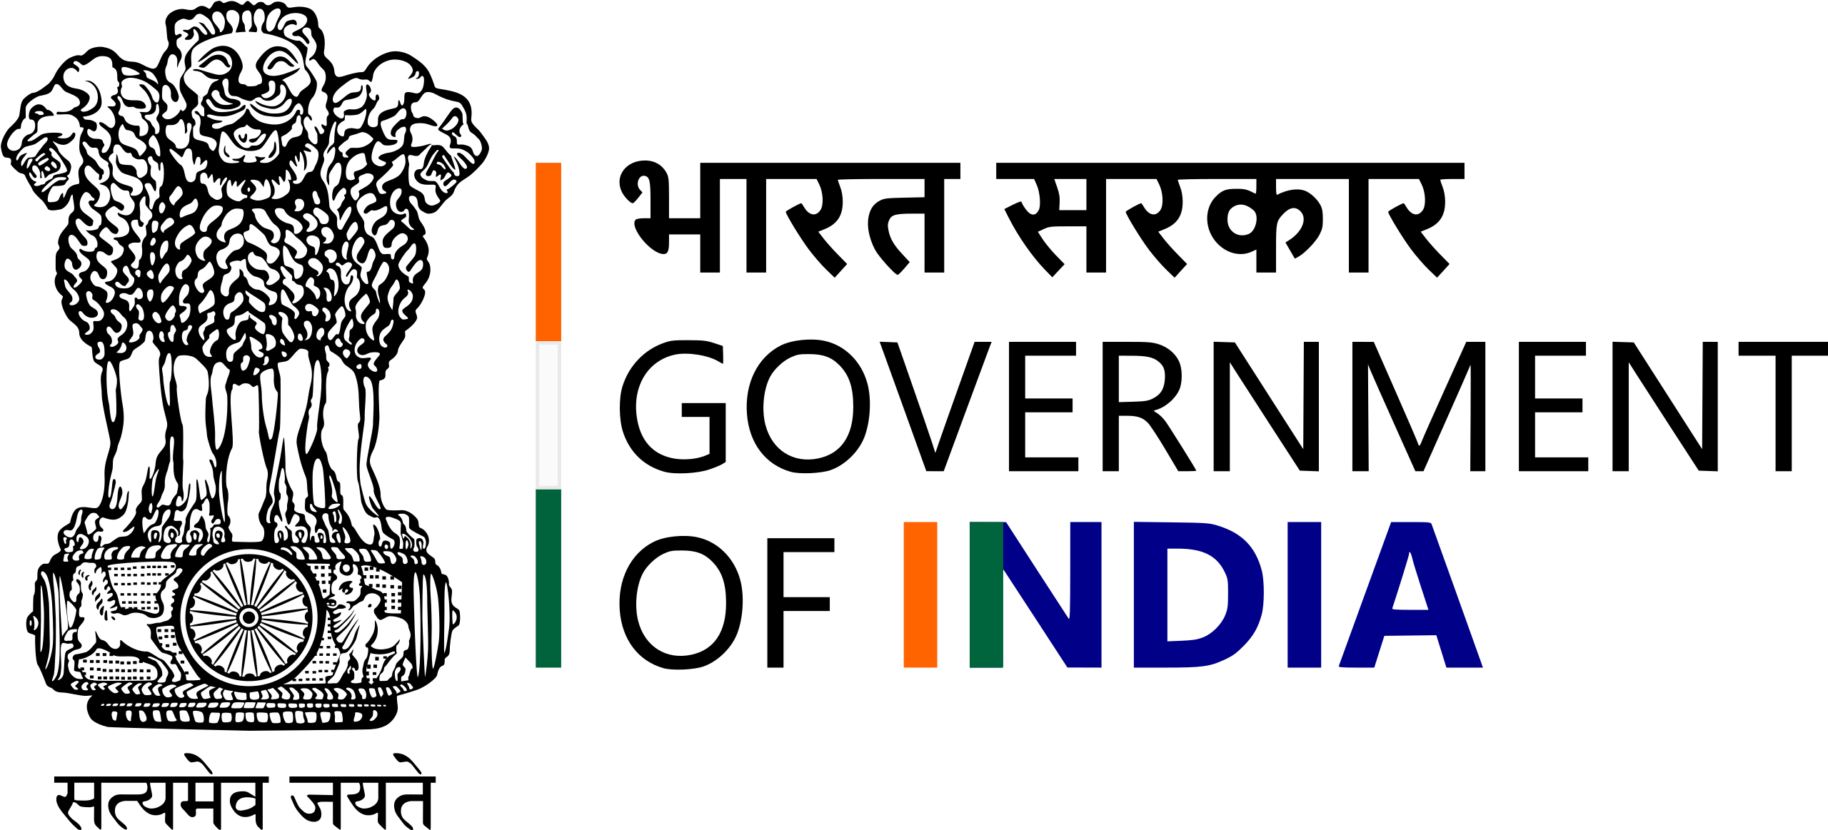
National Policy Responses to Population Control
The Indian government has historically adopted strategic measures aimed at stabilizing population growth and improving demographic health.
1952: Family Planning Program
1
India became the first country in the world to start a government program for controlling population
2
1970s: Focus on Sterilization
The program changed, with a strong focus on large-scale sterilization drives, which became controversial for aiming to slow population growth quickly
2000: National Population Policy (NPP)
3
The NPP moved from forced actions to voluntary participation, promoting local planning and aiming to balance population growth by 2045
4
Current Strategy
Focus is on empowering women, encouraging later marriage, increasing education levels, and offering complete healthcare for mothers and children.

Slide 9





Strategic Steps for Sustainable Population Management
A multi-pronged approach combining education, incentives, and healthcare access is essential for successful population stabilization.
Education & Awareness
Incentivizing Small Families
Birth Control Access
Provide free and quality education that focuses on health, gender equality, and responsible family planning.
Start government programs that offer financial and social benefits to families that follow small-family rules.
Make different birth control options available and easy to access for all income groups without any bias.
Raising Marriage Age
Empowering Women
Enforce laws and encourage society to promote higher marriage ages for both men and women to help reduce births.
Increase women’s jobs and healthcare access, helping them become independent and confident in decision-making.

Slide 10
Population Outlook and Future Challenges
1.5B
20Y
40%
Projected Peak Population
Duration of Youthfulness
Deceleration Factor
Better education and awareness programs are the main reasons for the major slowdown in population growth.
India’s population is expected to reach around 1.5 billion people by the mid-2030s, based on the current fall in birth rates.
India will stay a ‘young’ nation for about the next 20 years, keeping its advantage of having a large working-age population.
The paramount challenge ahead is ensuring the creation of adequate, high-quality jobs and the sustainable provision of resources for this massive, skilled workforce.

Slide 11


Conclusion: Navigating the Future
Population growth is a double-edged sword — it can drive progress if managed well or slow it down if ignored
Opportunity: India’s young population can become a strong force for growth and new ideas if their skills are used properly
Imperative: The government and people must work together to control population growth and ensure fair access to resources.
The Way Forward: Prioritizing education, healthcare, and economic empowerment ensures the creation of a healthy, developed, and sustainable nation for all its citizens.

Slide 12
THANK YOU
SUBMITTED TO: SIMRANJEET SIR

